Slide 1
Final Presentation research on insurance industry
ALY 6040
He Li, Yuqian Yang, Dongling Jiang, Tiantian You
Notes:
Hello everyone, my name is Leran Zhu. And here are my teammates: He Li,Yangmei Su, Wei Luo, Zimei Wang

Slide 2
Introduction
In this presentation, we will introduce our research process and results in four aspects: data cleaning and preprocessing, EDA, modeling and optimization, recommending the best model for insurance companies and providing business insights.
In this project, our team selected the medical insurance data from Kaggle. Our core variable is "charge", which is the premium paid by the customer. Next, we will target the program to predict the future medical expenses of individuals and help medical insurance make the decision to collect insurance premiums.
First, we use linear regression to establish the relationship between charges and other variables. Next, we use KNN, SVM, GBM, XGB and RF models to forecast the cost, and adjust the model parameters to avoid data over fitting.

Slide 3

Analysis: About the data set
Where did the data come from?
We downloaded customer information data about a health insurance company from Kaggle. This data set contains medical costs of people characterized by certain attributes. There are total of 7 attributes and 9359 records. These customer attributes include: age, gender, body mass index, number of children, Smoking habits, and region. We will analyze these customer information to make the best business decisions for the medical insurance company.

Slide 4
Analysis: About the data set
Why did you choose this data ?
We will explain the reasons why we chose this data set from two aspects. First of all, the data set is well structured, and the provider has done enough data cleaning. This will make it easy for us to carry out the analysis work and excavate valuable information from it.
Second, through the analysis of health insurance customer information, insurance companies can adjust the structure, direction and scale of insurance expenditure. In addition, it can help insurance companies to better control the risk of capital utilization and maximize the benefits of capital utilization on the basis of maintaining value. We will summarize the rules of insurance spending with different customer attributes, which will help regulators control and prevent risks in the health insurance industry.

Slide 5
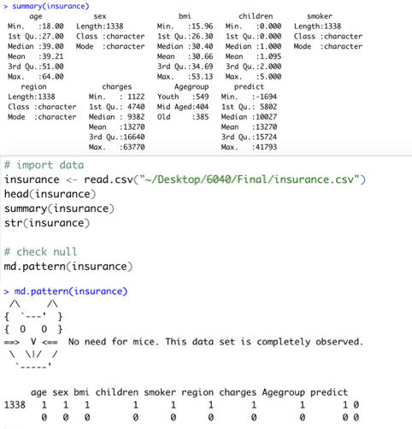
Analysis: Import data, get a preliminary understanding of the data, check the integrity
As can be seen from the figure, our data set is very complete, so we don't need to do too much data cleaning. The following data preprocessing will focus more on our analysis requirements.

Slide 6
Analysis: Data preprocessing
We have regrouped the "age" segment -- youth (18-35), middle age (35-50), and old age (50-68) -- to help us better understand the relevance of age data
# Create Agegroup & data pre-process
insurance <- as_tibble(insurance)
levels(insurance$sex)<-c("F","M")
#Create Agegroup column
insurance %>%
select_if(is.numeric) %>%
map_dbl(~max(.x))
insurance <-insurance %>%
mutate(Agegroup=as.factor(findInterval(age,c(18,35,50,80))))
levels(insurance$Agegroup)<-c("Youth","Mid Aged","Old")
levels(insurance$smoker)<-c("N","Y")
levels(insurance$region)<-c("NE","NW","SE","SW")
We also write abbreviations for some variables to facilitate drawing and analysis.

Slide 7
Analysis: EDA
In this part, first, we fully understand the distribution, structure and proportion of a single attribution. For example, we plotted a histogram showing the largest beneficiaries of young people are those who aged 18 and 19 years, and through the box-plot we found that the cost component showed a significantly skewed distribution.
We then look at the structural distribution of specific groups in the dataset by combining several different basic attributes. For example, we plotted the data by combining age, gender, region and cost to analyze the possible relationships among the data.

Slide 8
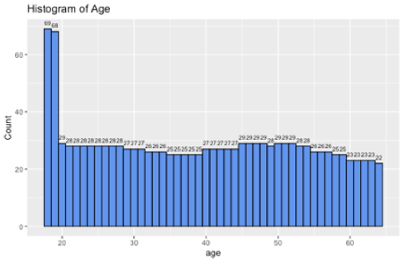
Analysis: EDA
As can be seen from the figure, young people aged 18 and 19 are the most profitable group. Besides this group, 'age' seems be distributed quiet uniformly.
The figure shows the proportion of male and female in the dataset. In the total 1338 cases, 676 cases were male (51%) and 662 cases were female (49%).

Slide 9
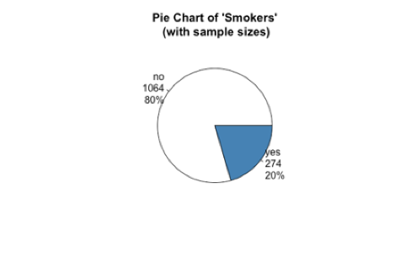
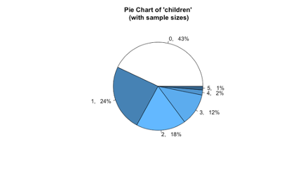
Analysis: EDA
In terms of whether to smoke, 1,064 non-smokers accounted for 80% and 274 smokers accounted for 20%.
This chart shows that very few people have more than 3 children. 75% of the people have 2 or less children.

Slide 10
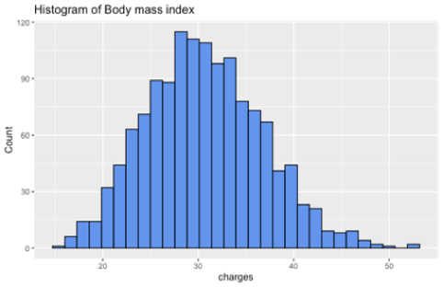
Analysis: EDA
As you can see from this histogram, ’BMI' looks quiet normally distributed. To further verify, we also plotted the density plot to show the distribution shape.

Slide 11
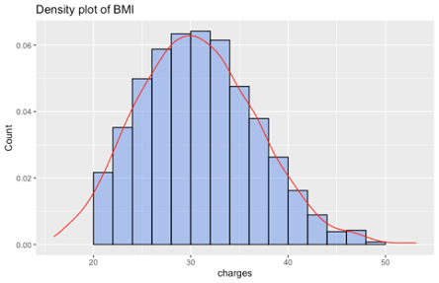
Analysis: EDA
density plot of BMI showing the shape of distribution

Slide 12
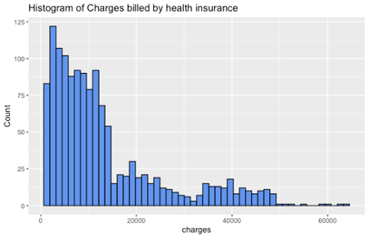
Analysis: EDA
This histogram shows us the distribution of ‘Charges’. We can learn from this chart that almost nobody’s charges are over 50000.
In the meanwhile, the distribution of 'charges' are highly right-skewed. To take a further look at this data, we plotted the box-plot.

Slide 13
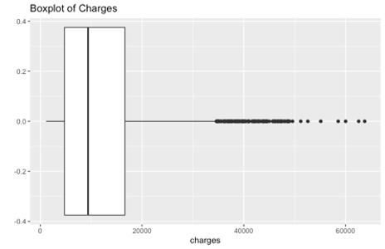
Analysis: EDA
From this chart, we found that ’charges’ variable is highly skewed. There are quiet a lot of extreme values.
After we completed the study of all the individual attributes, we attempted to combine part of the data for preliminary exploration.

Slide 14
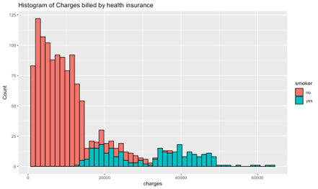
Analysis: EDA
The graph shows that the health care costs of smokers are much higher than that of non-smokers.
Next, we tried to combine the relationship between BMI and charges, and at the same time, we added smoking data into the mapping.

Slide 15
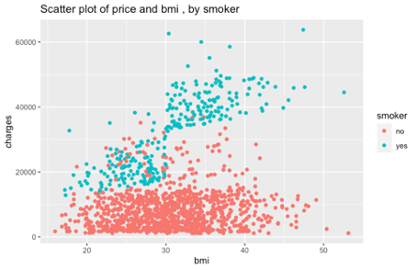
Analysis: EDA
We think this picture reflects only limited information, such as high charges and high BMI have certain correlation (need to further explore), most of the high charges with a high BMI, although most of the high charges and higher BMI are smoke group, lower BMI also has a number of peer group of smoking, so also need to further study the correlation between smoking and BMI.

Slide 16
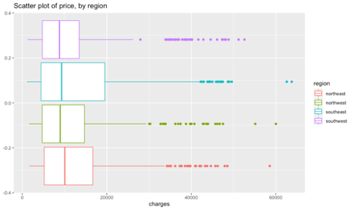
Analysis: EDA
As shown in the figure, southeast has the highest charge distribution and the deviation appears later, while southwest has the lowest cost distribution and the deviation appears first.

Slide 17
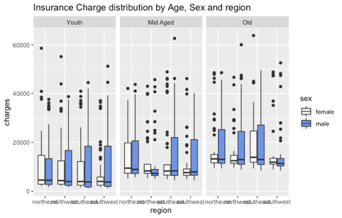
Analysis: EDA
From the graph, it appears that those above 50 years old are likely to pay more and living in the North East saves you some money spent on insurance charges.
However, we see a lot of points that lie out of this general trend. Most people would filter these out, but we will take a look to see who these really are.

Slide 18
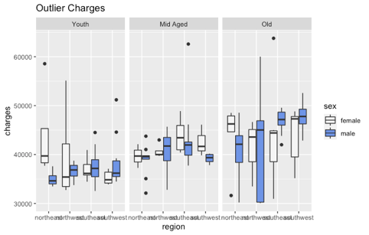
Analysis: EDA
From the above plot we can make a few observations for the outlier:
Females are charged more
Charges are region specific

Slide 19
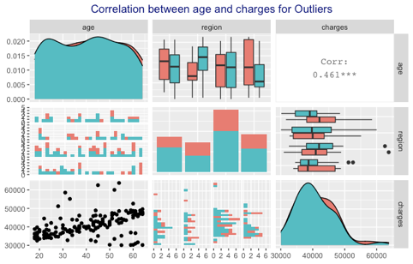
Analysis: Correlation
We first followed up the above study and carried out a correlation analysis for Outlier

Slide 20
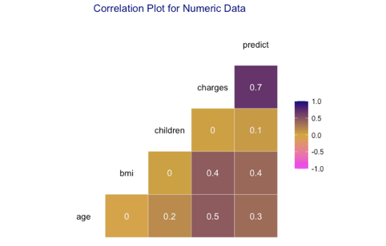
Analysis: Correlation
The above plot suggests a fairly low correlation between age and charges for our outliers.

Slide 21
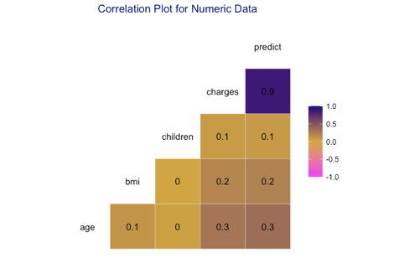
Analysis: Correlation
Then we check the correlation for the entire data set：
Again, we see a very low correlation for these outliers and also for the entire data set although there seems to be a pretty strong correlation between charges and BMI and charges and age .

Slide 22
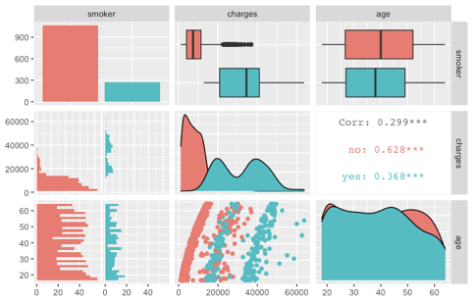
Analysis: Correlation
Correlation based on Age and Smoking：
The idea is that the charge distribution is such that there are higher charges for smokers than non-smokers.
There appears to be a linear trend in the data. We can see that for the charges below 20,000, there is a strong linear correlation between charges and age. There is also some outlier in this data. Let's take a look at what's special about these person.

Slide 23
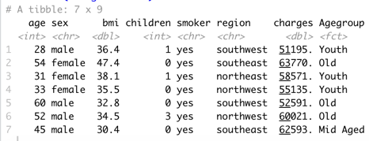
Analysis: Correlation
We find that they all have one thing in common: they are all smokers. So we can guess that smoking has the greatest impact on fees, especially considering that most of the high-cost groups have a near-normal BMI and no children.

Slide 24
Modeling
A. Linear regression
First, we chose the simplest linear regression to model, and at the same time, we selected the model with the lowest AIC through step function
ins_model_null <- lm(charges ~ 1, data=insurance)
ins_model_full <- lm(charges ~ ., data=insurance)
step(ins_model_null,
scope = list(upper=ins_model_full),
direction="both",
data= insurance)
ins_model_final <- lm(formula = charges ~ smoker + age + bmi + children + Agegroup +
region, data = insurance)
summary(ins_model_final)

Slide 25
Modeling
Signif. codes: 0 ‘***’ 0.001 ‘**’ 0.01 ‘*’ 0.05 ‘.’ 0.1 ‘ ’ 1
Residual standard error: 6032 on 1328 degrees of freedom
Multiple R-squared: 0.7535, Adjusted R-squared: 0.7519
F-statistic: 451.2 on 9 and 1328 DF, p-value: < 2.2e-16
R-squared is 0.7535, and our model more accurately represents the data of the data set
Call:
lm(formula = charges ~ smoker + age + bmi + children + Agegroup +
region, data = insurance)
Residuals:
Min 1Q Median 3Q Max
-11261.5 -2906.4 -947.4 1388.5 31003.4
Coefficients:
Estimate Std. Error t value Pr(>|t|)
(Intercept) -10961.73 1237.88 -8.855 < 2e-16 ***
smokeryes 23892.11 410.25 58.237 < 2e-16 ***
age 225.15 35.19 6.398 2.18e-10 ***
bmi 334.74 28.45 11.767 < 2e-16 ***
children 588.53 140.38 4.193 2.94e-05 ***
AgegroupMid Aged -620.89 730.38 -0.850 0.3954
AgegroupOld 1360.26 1189.42 1.144 0.2530
regionnorthwest -367.52 473.96 -0.775 0.4382
regionsoutheast -1014.34 476.38 -2.129 0.0334 *
regionsouthwest -968.67 475.61 -2.037 0.0419 *
---

Slide 26
Modeling
Next, we test the model.
At the beginning we study the multicollinearity of the model
vif(ins_model_final)
GVIF Df GVIF^(1/(2*Df))
smoker 1.007811 1 1.003898
age 8.982015 1 2.997001
bmi 1.105671 1 1.051509
children 1.052171 1 1.025754
Agegroup 9.401147 2 1.751037
region 1.099521 3 1.015938
They both <10, this indicate that the model has no multicollinearity problem

Slide 27
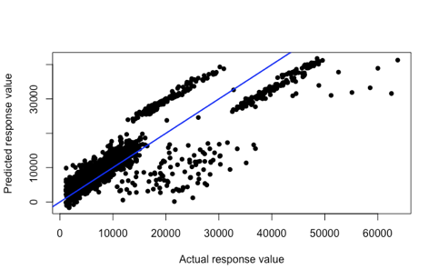
Modeling
plot(predict ~ charges,
data= insurance,
pch = 16,
xlab="Actual response value",
ylab="Predicted response value")
abline(0,1, col="blue", lwd=2)
hist(residuals(ins_model_final),
col=“darkgray")
From the graph, our model fits most of the data accurately, which is an accurate model for this data set. At the same time, we can also get further verification from the histogram

Slide 28
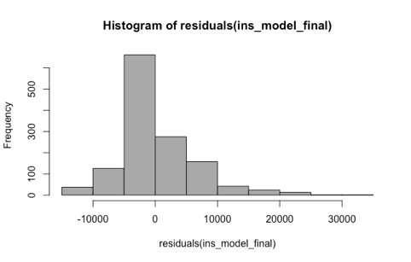
Modeling
This graph can better see the distribution of numerical residuals predicted based on the model we designed, most of which are based on the left side of 0

Slide 29
Modeling
B. Multi-model to predict charges
We first divided the data set into training group and test group
trainds <- createDataPartition(insurance$Agegroup,p=0.7,list=F)
validate <- insurance[-trainds,]
trainds <- insurance[trainds,]
#Set metric and control
control<-trainControl(method="cv",number=10)
metric<-"RMSE"

Slide 30
Modeling
We used up to 5 algorithms, KNN, SVM, GBM, XGB and random forest：
set.seed(123)
fit.knn<-train(charges~.,data=trainds,method="knn",trControl=control,metric=metric)
set.seed(123)
fit.svm<-train(charges~.,data=trainds,method="svmRadial",trControl=control,metric=metric)
set.seed(123)
fit.gbm<-train(charges~.,data=trainds,method="gbm",trControl=control,metric=metric,
verbose=F)
set.seed(123)
fit.xgb<-train(charges~.,data=trainds,method="xgbTree",trControl=control,metric=metric,
verbose=F)
set.seed(123)
fit.rf<-train(charges~.,data=trainds,method=”rf",trControl=control,metric=metric,
verbose=F)
results<-resamples(list(knn=fit.knn,svm=fit.svm,xgb=fit.xgb,gbm=fit.gbm,rf=fit.rf))

Slide 31
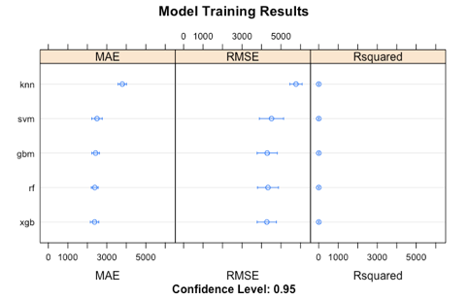
Modeling
We see that the best model is the Xgboost model.
We therefore print the model(s) to find the one which works best.

Slide 32
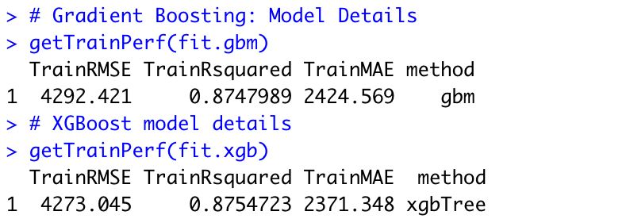
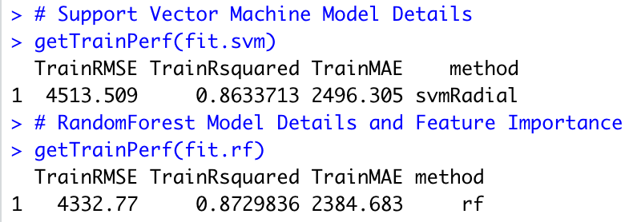
Modeling
In general, Gradient Boosting Model, XGBoost Model, RandomForest Model have similar simulation effect, which all can be adopted.

Slide 33
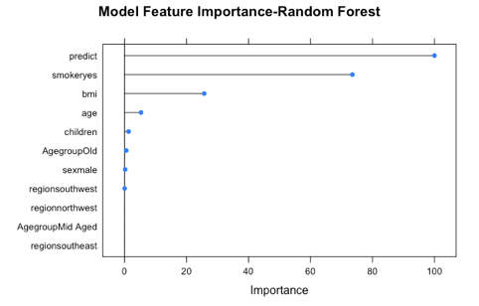
Modeling
We can see that the most important feature is whether a person smokes. As expected, the BMI and Age are also high up in the feature importance hierarchy possibly due to the high correlation with disease states. Think lung cancer, diabetes, Alzheimer's and hypertension.

Slide 34
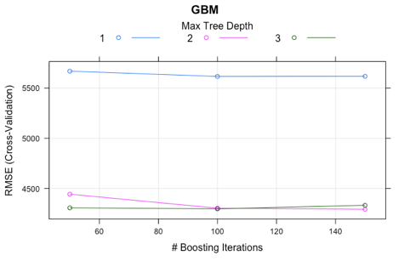
Modeling
We choose GBM model for the test of how does our model do on unseen data

Slide 35
Modeling
"RSE : 0.189738969583175”
"RMSE : 5050.98153521527"
We see that our model does a pretty good job on our "unseen" data. We could go on to tune our parameters until we get a better model or remove the outliers and use only the most important features. But our model was accurate enough that we decided to go into the second part of the study

Slide 36
Modeling
C. Logistic regression and decision tree
After analyzing the cost, We established a new model, We Used Logistic Regression and decision Tree Model to analyze whether customers smoke or not.
Before building the model, we first divided the data into groups. The training group was 70% and the test group was 30%. At the same time we replace the smoker with the binary num variable

Slide 37

Modeling
# logistic regression
ins_log <- glm(smoker ~ .,
data = ins_train, family = "binomial")
#Fit Test of Logistic Regression Model
prob<-predict(object = ins_log, newdata=ins_test, type = "response")
pred<-ifelse(prob >= 0.5, "yes", "no")
pred<-factor(pred,levels = c("no","yes"),order=TRUE)
f<-table(ins_test$smoker,pred)
f
Confusion matrix
Accuracy : (312+72)/(312+13+4+72) = 0.9576

Slide 38
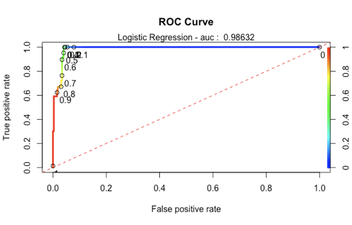
Modeling
we drew a ROC - AUC curve to evaluate our model
pred_lm = predict(ins_log, type='response', newdata=ins_test)
rocr.pred.lr = prediction(predictions = pred_lm, labels = ins_test$smoker)
rocr.perf.lr = performance(rocr.pred.lr, measure = "tpr", x.measure = "fpr")
rocr.auc.lr = as.numeric(performance(rocr.pred.lr, "auc")@y.values)
rocr.auc.lr
[1] 0.9863158

Slide 39
Modeling
We also built a decision tree model
# decision tree
ins_decision_tr = rpart(formula = smoker ~ .,
data = ins_train, method = "class")
rpart.plot(ins_decision_tr,type = 3, digits = 3, fallen.leaves = TRUE)

Slide 40
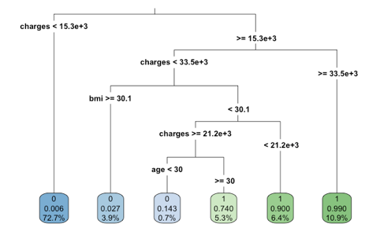
Modeling

Slide 41
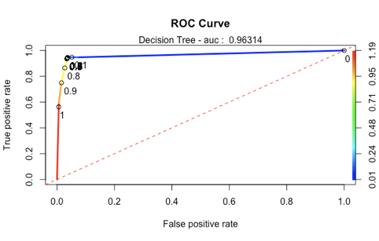
Modeling
Meanwhile, roc- AUC curve was also drawn to compare the two models
rocr.auc.dt
[1] 0.9631377

Slide 42
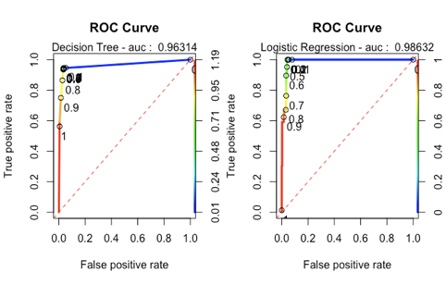
Modeling
Combining the two ROC-AUC curves, we can see from the image that the logistic regression model seems more accurate, so we choose the logistic regression model as the final model of this part.

Slide 43
Conclusions
In general, we use a series of models to predict and analyze the "charges" attribute. Xgboost, gradient boosting and random forest are models with high accuracy. Therefore, we will suggest that insurance companies use these three models to predict the insurance costs of customers and make targeted sales. In addition, we confirm that smoking is a key attribute affecting insurance costs. At the same time, the influence of age and BMI on charge is weak, and the influence of gender and region is the least.
Finally, we use logistic regression and decision tree to judge whether users have smoking habits. Medical insurance companies can classify customers according to their health insurance attributes and standards. We will also suggest that insurance companies charge different insurance premiums for different customer groups and implement corresponding measures.Insurance companies offer incentives or subsidies to families with children, patients and the elderly and charge higher fees to customers with health risks

Slide 44
reference
Jhaveri, M. (2020, May 23). Insurance_Healthcare. Retrieved July 12, 2020, from https://www.kaggle.com/mihirjhaveri/insurance-healthcare
Robk@statmethods.net, R. (n.d.). Histograms and Density Plots. Retrieved July 12, 2020, from https://www.statmethods.net/graphs/density.html
Why do you have to check your regression analysis with a residual plot? (n.d.). Retrieved July 19, 2020, from https://www.jianshu.com/p/c9022affd8b9
Application of predict function in regression analysis. (n.d.). Retrieved July 19, 2020, from https://blog.csdn.net/hsdcc217/article/details/78395240
Dalpiaz, D. (2019, March 22). R for Statistical Learning. Retrieved from July 18, 2020, from https://daviddalpiaz.github.io/r4sl/logistic-regression.html.
AUC，ROC. (n.d.). Retrieved July 18, 2020, from https://blog.csdn.net/u013385925/article/details/80385873
Brownlee, J. (2019, August 22). Machine Learning Evaluation Metrics in R. Retrieved July 18, 2020, from https://machinelearningmastery.com/machine-learning-evaluation-metrics-in-r/

Slide 45
reference
Vogler, R. (2016, June 11). Illustrated Guide to ROC and AUC. Retrieved August 11, 2020, from https://www.r-bloggers.com/illustrated-guide-to-roc-and-auc/
Brownlee, J. (2019, August 22). How To Estimate Model Accuracy in R Using The Caret Package. Retrieved August 11, 2020, from https://machinelearningmastery.com/how-to-estimate-model-accuracy-in-r-using-the-caret-package/
Anishkanth. (2019, July 14). Insurance Premium - RMSE - 6367. Retrieved August 11, 2020, from https://www.kaggle.com/anishkanth/insurance-premium-rmse-6367
Aarshay JainAarshay graduated from MS in Data Science at Columbia University in 2017 and is currently an ML Engineer at Spotify New York. He works at an intersection or applied research and engineering while designing ML solutions to move product metrics. (2020, July 05). Gradient Boosting: Hyperparameter Tuning Python. Retrieved August 11, 2020, from https://www.analyticsvidhya.com/blog/2016/02/complete-guide-parameter-tuning-gradient-boosting-gbm-python/

Slide 46
Thank you

